Slide 1
Chapter 2 Basic Structures
Section 2
Set Operations

Slide 2
Outline
Set Operations
Set Identities恒等式
Generalized Unions and Intersections

Slide 3
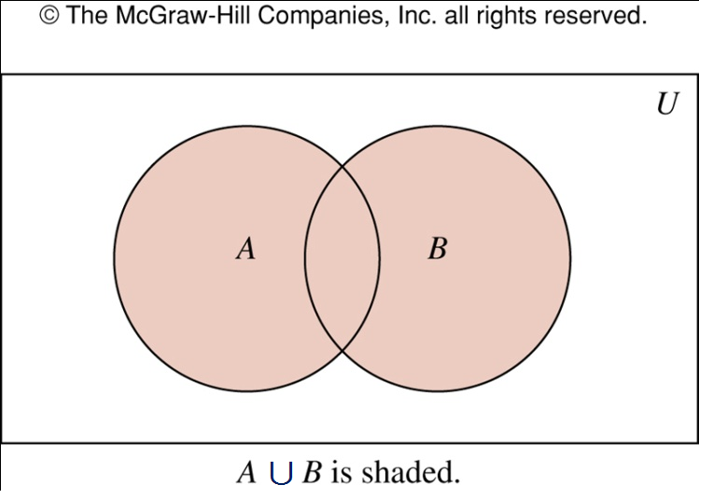
Set Union
Union 并运算
  the set that contains those elements that are either in A or in B, or in both
  described as A∪B={x|x∈A∨x∈B}
  Example
    A={1, 3, 5}, B={1, 2, 3}, A∪B={1, 2, 3, 5}

Slide 4
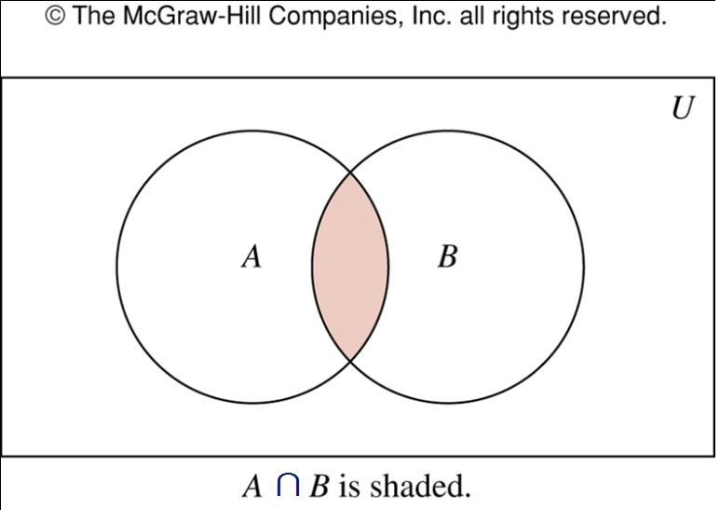
Set Intersection
Intersection 交运算
  the set containing the elements in both A and B ()
  described as A∩B={x|x∈A∧x∈B}
  Example
    A={1, 3, 5}, B={1, 2, 3}, A∩B={1, 3}

Slide 5
Disjoint Sets
Disjoint 不相交
  Two sets are disjoint if their intersection is ∅
  Example
    A={1, 3}, B={2, 4}, A and B are disjoint
Inclusion-Exclusion principle 容斥原理
  Cardinality |A∪B|=|A|+|B|-|A∩B|

Slide 6
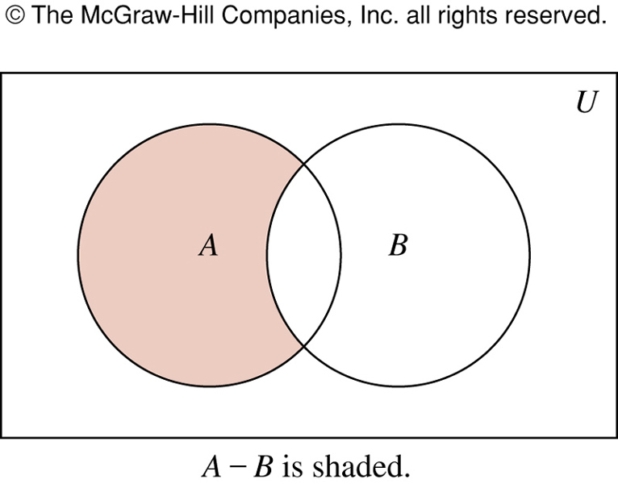
Set Difference
Difference 差运算
  A-B: the set containing those elements in A but not in B
  described as A-B={x|x∈A∧x∉B}
  A-B is also called the complement of B with respect to A
  Example
    A={1, 3, 5}, B={1, 2, 3}, A-B={5}

Slide 7
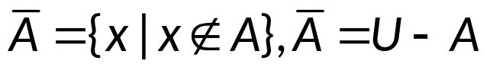
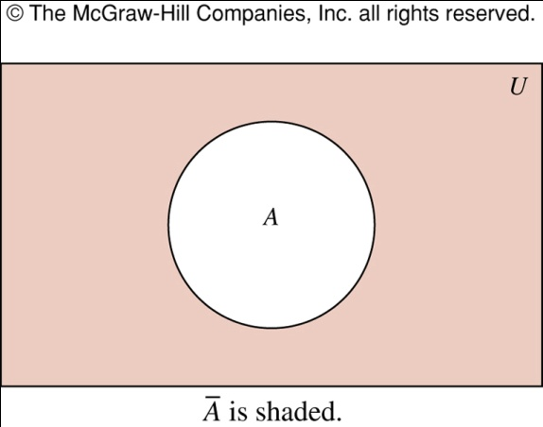
Complement of a Set
Complement of set A 补运算
  Once the universal set U is specified, the complement of a set A can be defined as

Slide 8
Complement of a Set
  Example
    A is the set of positive integers > 10 and the universal set is the set of all positive integers, then

Slide 9
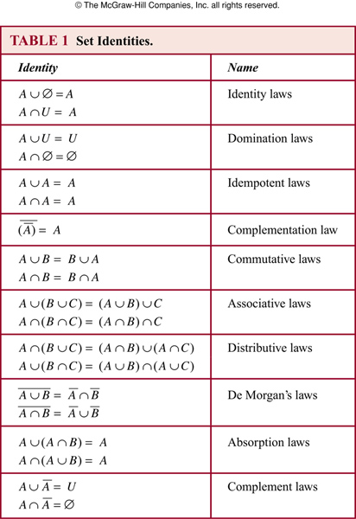
Set Identities
Set Identities 集合恒等式

Slide 10
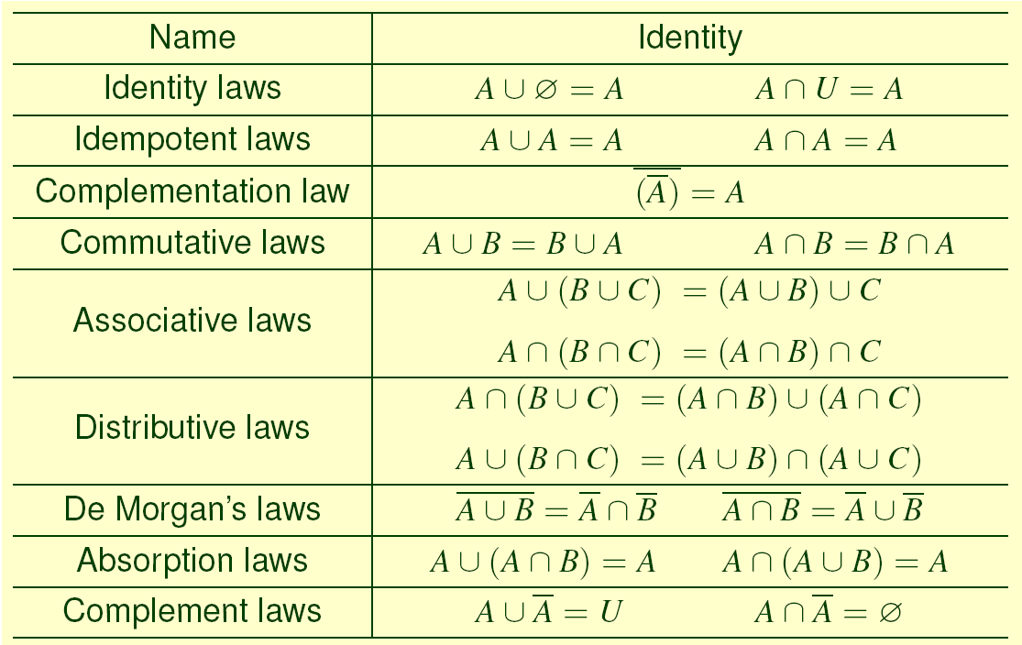
Set Identities

Slide 11
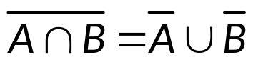
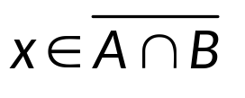
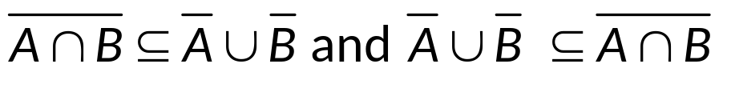
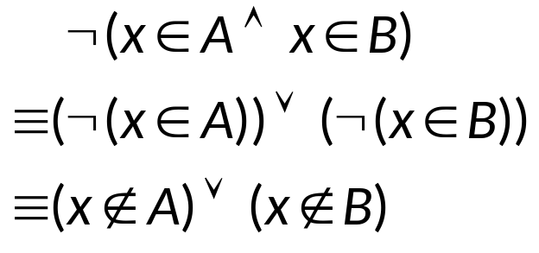
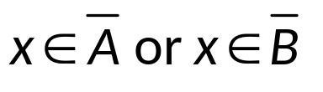
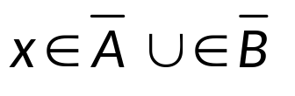
Set Identities
Example
  show that
  (⇒): Suppose that , by definition of complement and use De Morgan’s law
    By definition of complement
    By definition of union

Slide 12
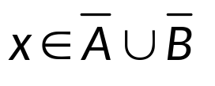
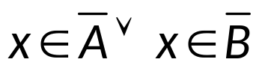


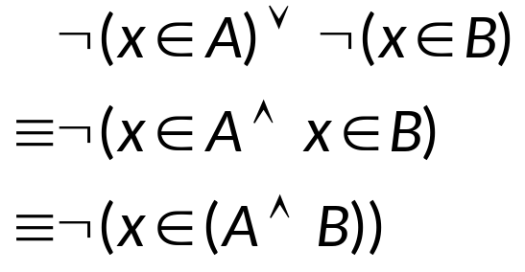
Set Identities
  (⇐): Suppose that
    By definition of union
    By definition of complement
    Thus
    By De Morgan’s law:
    By definition of complement,

Slide 13
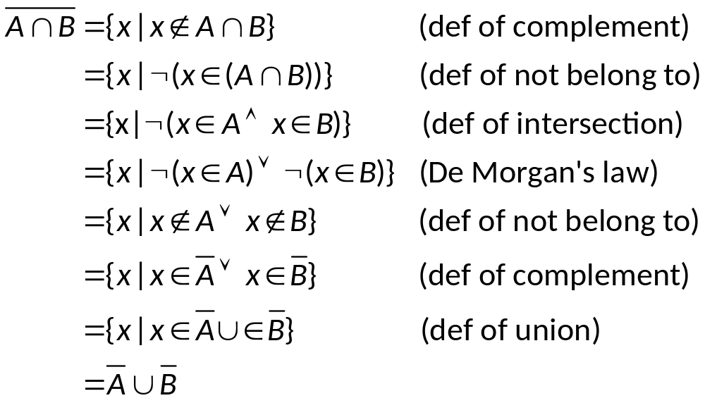
Set Identities
Example
  Prove the last example with builder notation
  Solution

Slide 14
Set Identities
Example
  Prove A∩(B∪C)=(A∩B)∪(A∩C)
  (⇒): Suppose that x∈A∩(B∪C), then x∈A and x∈B∪C. By definition of union, it follows that x∈A, and x∈B or x∈C . Consequently, x∈A and x∈B, or x∈A and x∈C
    By definition of intersection, it follows x∈A∩B or x∈A∩C
    By definition of union, x∈(A∩B)∪(A∩C)

Slide 15
Set Identities
  (⇐): Suppose that x∈(A∩B)∪(A∩C)
    By definition of union, x∈A∩B or x∈A∩C
    By definition of intersection, x∈A and x∈B , or x∈A and x∈C
    From this, we see x∈A , and x∈B or x∈C
    By definition of union, x∈A and x∈B∪C
    By definition of intersection, x∈A∩(B∪C). This completes the proof.

Slide 16
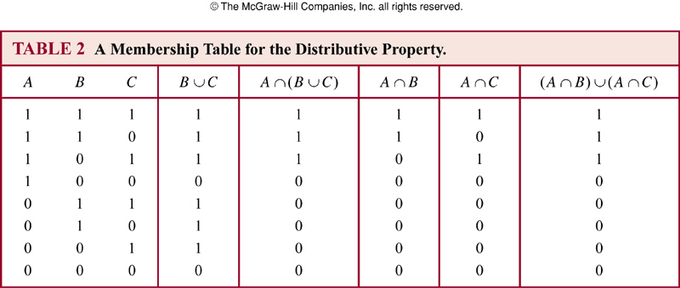
Set Identities
Consider each combination of sets that an element can belong to and verify that elements in the same combinations of sets belong to both the sets in the identity

Slide 17

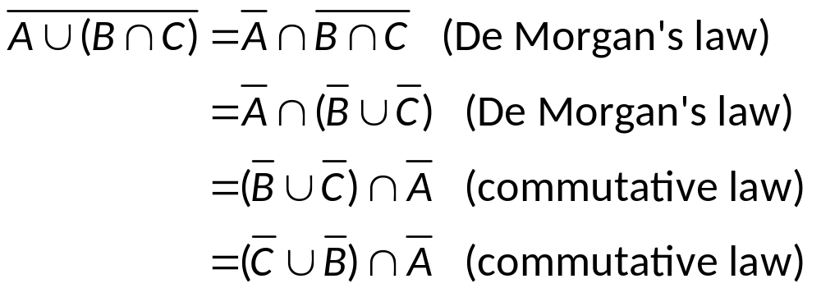
Set Identities
Example
  Show that
  Solution
    Additional set identities can be established using those we have already proved

Slide 18
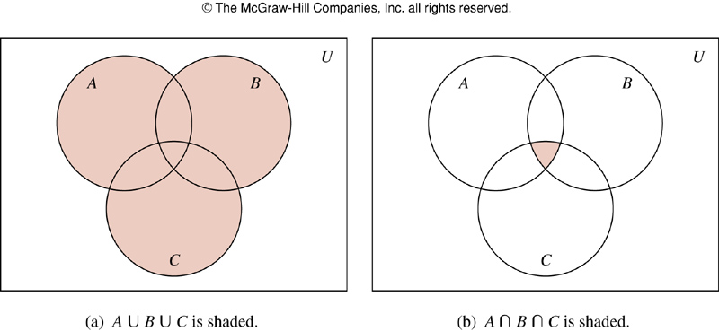
Generalized Union and Intersection
Generalized Union and Intersection
  Unions and intersections of sets satisfy associative laws and the forms of A∪B∪C and A∩B∩C are well-defined

Slide 19
Generalized Union and Intersection
Example
  Let A={0, 2, 4, 6, 8}, B={0, 1, 2, 3, 4}, C={0, 3, 6, 9}, then
    A∪B∪C = {0, 1, 2, 3, 4, 6, 8, 9}
    A∩B∩C = {0}

Slide 20
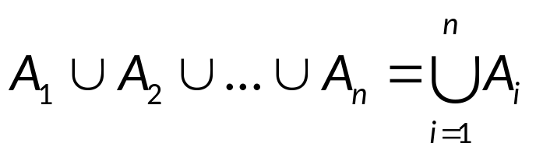
Generalized Union and Intersection
Example
  The union of a collection of sets is the set tat contains those elements that are members of at least one set in the collection
  The union of the sets A₁, A₂, … , A_{n} is denoted by

Slide 21
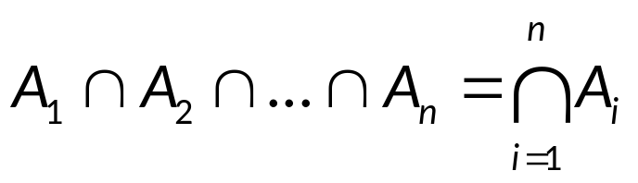
Generalized Union and Intersection
  The intersection of a collection of sets is the set tat contains those elements that are members of all the sets in the collection
  The intersection of the sets A₁, A₂, … , A_{n} is denoted by

Slide 22
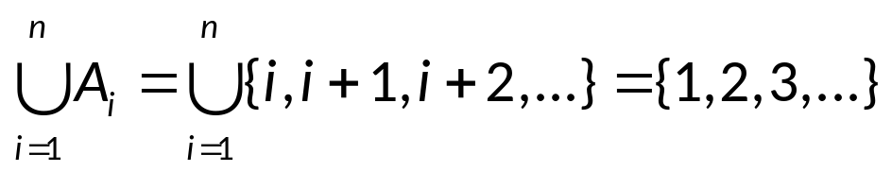
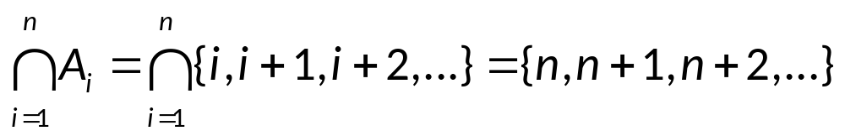
Generalized Union and Intersection
Example
  Let A_{i}={i, i+1, i+2, …}, then

Slide 23
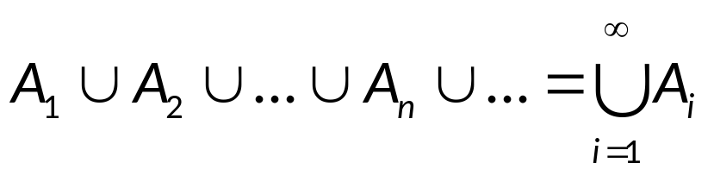

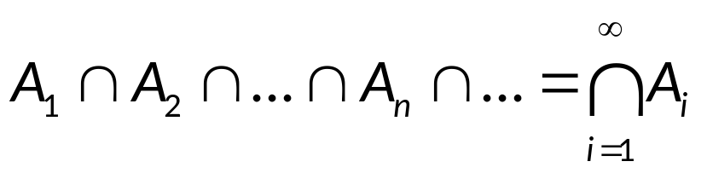

General Cases
Extend to more general cases
  Union:
  Intersection:

Slide 24
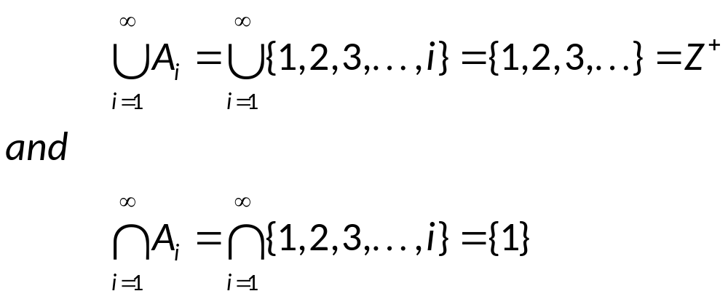
General Cases
Example
  Suppose A_{i}={1, 2, 3,…, i} for i=1,2,3,… then

Slide 25
Computer Representation of Sets
Bit strings
  A bit string is a sequence of bits (with symbols 0 and 1)
Representation of Sets with Bit strings
  Suppose U={1,2,3,4,5,6,7,8,9,10}
  Let A={1,3,5,7,9},B={1,2,3,4,5}
  Represent A as 1010101010, and B as 1111100000
  Complement of A: 0101010101
  A∩B: 1010101010˄1111100000=1010100000 which corresponds to {1,3,5}
  A∪B: 1010101010∨1111100000=1111101010 which corresponds to {1,2,3,4,5,7,9}

Slide 26
Assignment
Exercises after 2.2: 26, 30 (Ver.7)

